Slide 1

LOGISTIC OPTIMIZATION USING SQL
PRESENTATION LINK
ALL TASKS OUTPUT LINK
SENTHAMIL SELVAN M
DATA ANALYST,INTERNSHALA

Slide 2
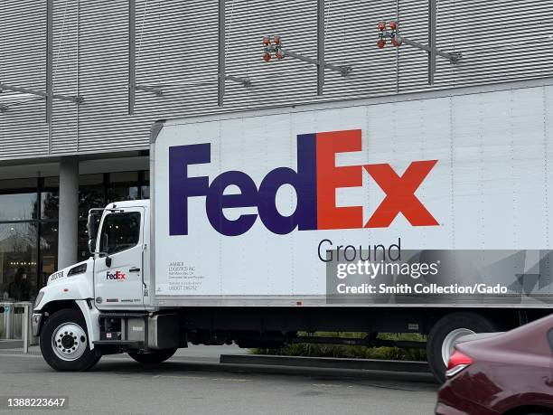

BUSINESS UNDERSTANDING
FedEx wants to improve its logistics operations by analyzing shipment delays, route efficiency, warehouse utilization, and agent performance.
The goal of this project is to:
  Understand performance across routes, warehouses, agents
  Optimize delivery performance
  Develop actionable insights using SQL queries

Slide 3


DATA SETS
This analysis uses 5 datasets:
Warehouses,
Shipments,
Routes,
Orders,
Delivery Agents.

Slide 4
DATA CLEANING AND PRE-PROCESSING
Steps Performed
  Checked for duplicate in shipments, orders,
  COUNT(*) - COUNT(DISTINCT column_name)...
  No major duplicate issues found (or mention if duplicates existed and were removed).
  Data types has been checked for pickup time and delivery time
  checked for NULL values in delay reasons, delivery status, agent_id, warehouse_id
  Referential Integrity checks(JOIN WITH WHERE CLAUSE)

Slide 5

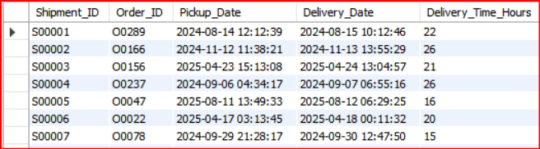
2.DELIVERY DELAY ANALYSIS
1.DELIVERY DELAY (IN HOURS) FOR EACH SHIPMENT USING DELIVERY_DATE – PICKUP_DATE.
SELECT Shipment_ID,Order_ID,Pickup_Date,Delivery_Date,TIMESTAMPDIFF(HOUR, Pickup_Date, Delivery_Date) AS Delivery_Time_Hours
FROM fedex_shipments
QUERY
OUTPUT

Slide 6
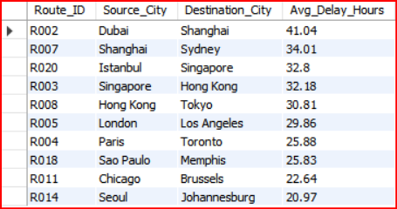
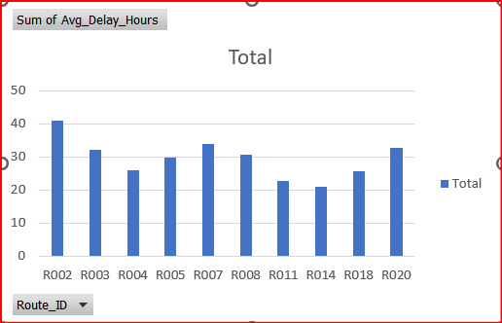
2.DELIVERY DELAY ANALYSIS
TOP 10 DELAYED ROUTES BASED ON AVERAGE DELAY HOURS
SELECT r.Route_ID, r.Source_City, r.Destination_City,ROUND(AVG(s.Delay_Hours),2) AS Avg_Delay_Hours
FROM fedex_shipments s
JOIN fedex_routes r ON s.Route_ID = r.Route_ID
GROUP BY r.Route_ID, r.Source_City, r.Destination_City
ORDER BY Avg_Delay_Hours DESC
LIMIT 10;
QUERY
OUTPUT
Delayed routes

Slide 7
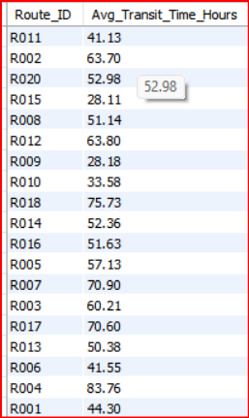
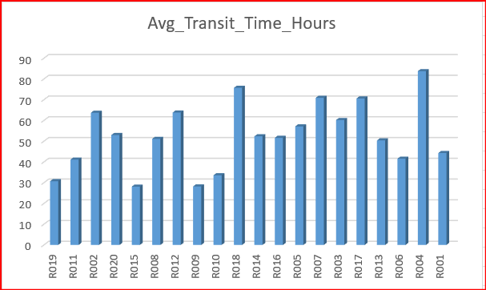
3.ROUTE OPTIMIZATION INSIGHTS
AVERAGE TRANSIT TIME (IN HOURS) ACROSS ALL SHIPMENTS.
QUERY
SELECT r.Route_ID, ROUND(AVG(TIMESTAMPDIFF(HOUR, s.Pickup_Date, s.Delivery_Date)), 2) AS Avg_Transit_Time_Hours
FROM fedex_shipments s
JOIN fedex_routes r
ON s.Route_ID = r.Route_ID
GROUP BY r.Route_ID;
OUTPUT

Slide 8
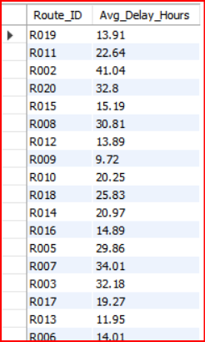
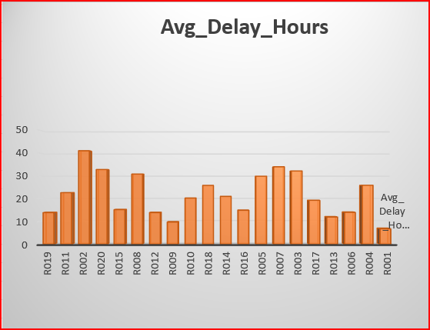
3.ROUTE OPTIMIZATION INSIGHTS
AVERAGE DELAY (IN HOURS) PER ROUTE.
SELECT r.Route_ID, ROUND(AVG(s.Delay_Hours), 2) AS Avg_Delay_Hours
FROM fedex_shipments s
JOIN fedex_routes r
ON s.Route_ID = r.Route_ID
GROUP BY r.Route_ID
QUERY
OUTPUT

Slide 9
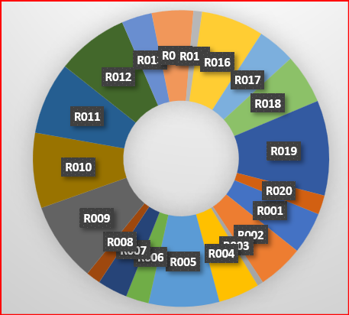
3.ROUTE OPTIMIZATION INSIGHTS
DISTANCE-TO-TIME EFFICIENCY RATIO = DISTANCE_KM / AVG_TRANSIT_TIME_HOURS.
SELECT t.Route_ID, t.Distance_KM, t.Avg_Transit_Time_Hours,
ROUND(t.Distance_KM / t.Avg_Transit_Time_Hours, 2) AS Efficiency_Ratio
FROM (SELECT r.Route_ID,r.Distance_KM,ROUND(AVG(TIMESTAMPDIFF(HOUR, s.Pickup_Date, s.Delivery_Date)), 2) AS Avg_Transit_Time_Hours
FROM fedex_shipments s
JOIN fedex_routes r
ON s.Route_ID = r.Route_ID
GROUP BY r.Route_ID, r.Distance_KM) t;
QUERY
OUTPUT

Slide 10

3.ROUTE OPTIMIZATION INSIGHTS
3 ROUTES WITH THE WORST EFFICIENCY RATIO (LOWEST DISTANCE-TO-TIME).
SELECT *
FROM ( SELECT r.Route_ID,r.Distance_KM,ROUND(AVG(TIMESTAMPDIFF(HOUR, s.Pickup_Date, s.Delivery_Date)), 2) AS Avg_Transit_Time_Hours,
ROUND(r.Distance_KM / AVG(TIMESTAMPDIFF(HOUR, s.Pickup_Date, s.Delivery_Date)), 2) AS Efficiency_Ratio
FROM fedex_shipments s
JOIN fedex_routes r
ON s.Route_ID = r.Route_ID
GROUP BY r.Route_ID, r.Distance_KM) t
ORDER BY Efficiency_Ratio ASC
LIMIT 3;
QUERY
OUTPUT

Slide 11
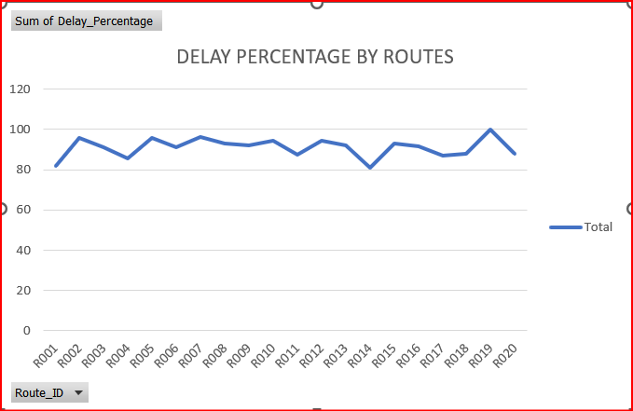
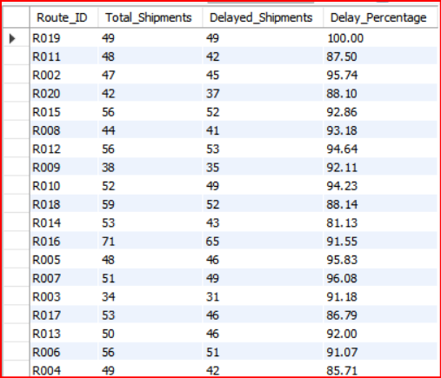
3.ROUTE OPTIMIZATION INSIGHTS
ROUTES WITH >20% OF SHIPMENTS DELAYED BEYOND EXPECTED TRANSIT TIME
SELECT r.Route_ID,COUNT(*) AS Total_Shipments,
SUM(TIMESTAMPDIFF(HOUR, s.Pickup_Date, s.Delivery_Date) > r.Avg_Transit_Time_Hours) AS Delayed_Shipments,
ROUND(SUM(TIMESTAMPDIFF(HOUR, s.Pickup_Date, s.Delivery_Date) > r.Avg_Transit_Time_Hours)/ COUNT(*) * 100, 2) AS Delay_Percentage
FROM fedex_shipments s
JOIN fedex_routes r
ON s.Route_ID = r.Route_ID
GROUP BY r.Route_ID
HAVING Delay_Percentage > 20;
QUERY
OUTPUT

Slide 12
3.ROUTE OPTIMIZATION INSIGHTS
RECOMMENDATIONS
  Routes R003, R015, and R008 show the poorest distance-to-time efficiency. Improving these routes transit paths and rebalancing warehouse loads can significantly reduce overall delay and enhance FedEx delivery reliability.
  From the delay charts:Multiple routes consistently show delay percentages above 80–90%.
Avg Delay Hours is also high for R002, R005, R007, R013, etc.

Slide 13
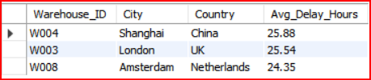
WAREHOUSE PERFORMANCE
TOP 3 WAREHOUSES WITH THE HIGHEST AVERAGE DELAY IN SHIPMENTS DISPATCHED
SELECT w.Warehouse_ID, w.City, w.Country, ROUND(AVG(s.Delay_Hours), 2) AS Avg_Delay_Hours
FROM fedex_shipments s
JOIN fedex_warehouses w
ON s.Warehouse_ID = w.Warehouse_ID
GROUP BY w.Warehouse_ID, w.City, w.Country
ORDER BY Avg_Delay_Hours DESC
LIMIT 3;
QUERY
OUTPUT

Slide 14
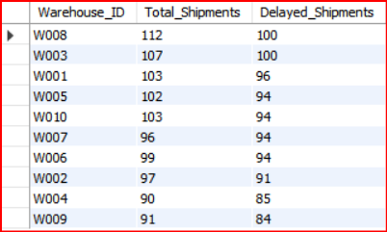
WAREHOUSE PERFORMANCE
TOTAL SHIPMENTS VS DELAYED SHIPMENTS FOR EACH WAREHOUSE.
SELECT s.Warehouse_ID, COUNT(*) AS Total_Shipments,SUM(CASE WHEN s.Delay_Hours > 0 THEN 1 ELSE 0 END) AS Delayed_Shipments
FROM fedex_shipments s
GROUP BY s.Warehouse_ID
ORDER BY Delayed_Shipments DESC;
QUERY
OUTPUT

Slide 15
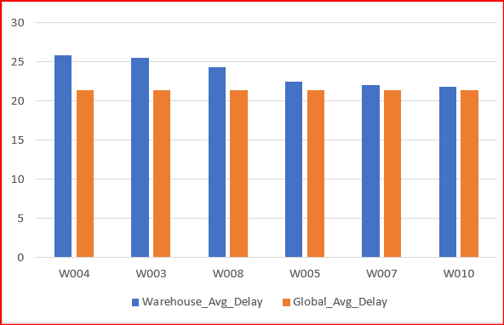
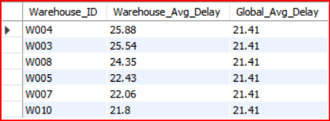
WAREHOUSE PERFORMANCE
WAREHOUSES WHERE AVERAGE DELAY EXCEEDS THE GLOBAL AVERAGE DELAY.
WITH GlobalAvg AS (SELECT AVG(Delay_Hours) AS Global_Avg_Delay FROM fedex_shipments),
WarehouseAvg AS (SELECT Warehouse_ID,AVG(Delay_Hours) AS Avg_Delay FROM fedex_shipments GROUP BY Warehouse_ID)
SELECT w.Warehouse_ID, ROUND(w.Avg_Delay, 2) AS Warehouse_Avg_Delay, ROUND(g.Global_Avg_Delay, 2) AS Global_Avg_Delay
FROM WarehouseAvg w
CROSS JOIN GlobalAvg g
WHERE w.Avg_Delay > g.Global_Avg_Delay
ORDER BY w.Avg_Delay DESC;
QUERY
OUTPUT

Slide 16
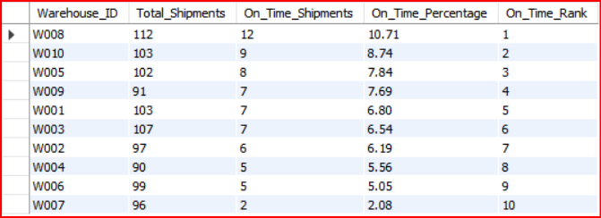
WAREHOUSE PERFORMANCE
RANK ALL WAREHOUSES BASED ON ON-TIME DELIVERY PERCENTAGE.
WITH WarehouseStats AS ( SELECT Warehouse_ID,COUNT(*) AS Total_Shipments,SUM(CASE WHEN Delay_Hours = 0 THEN 1 ELSE 0 END) AS On_Time_Shipments,
ROUND(SUM(CASE WHEN Delay_Hours = 0 THEN 1 ELSE 0 END) / COUNT(*) * 100,2) AS On_Time_Percentage
FROM fedex_shipments
GROUP BY Warehouse_ID)
SELECT Warehouse_ID,Total_Shipments, On_Time_Shipments, On_Time_Percentage,
RANK() OVER (ORDER BY On_Time_Percentage DESC) AS On_Time_Rank
FROM WarehouseStats
ORDER BY On_Time_Rank;
QUERY
OUTPUT

Slide 17
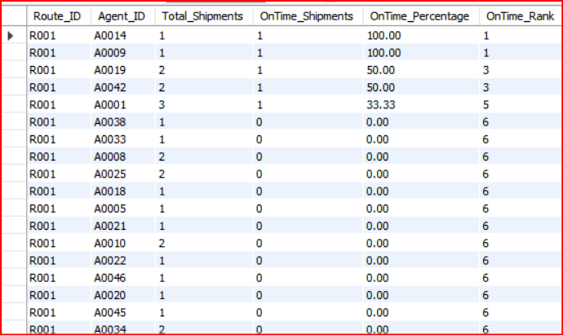
DELIVERY AGENT PERFORMANCE
RANK DELIVERY AGENTS (PER ROUTE) BY ON-TIME DELIVERY PERCENTAGE.
WITH agent_performance AS ( SELECT s.Route_ID, s.Agent_ID, COUNT(*) AS Total_Shipments, SUM(CASE WHEN s.Delivery_Status = 'Delivered' AND s.Delay_Hours <= 0 THEN 1 ELSE 0 END) AS OnTime_Shipments, ROUND(SUM(CASE WHEN s.Delivery_Status = 'Delivered'
AND s.Delay_Hours <= 0 THEN 1 ELSE 0 END)/ COUNT(*) * 100, 2) AS OnTime_Percentage
FROM fedex_shipments s
GROUP BY s.Route_ID, s.Agent_ID)
SELECT Route_ID,Agent_ID,Total_Shipments, OnTime_Shipments, OnTime_Percentage,RANK() OVER (PARTITION BY Route_ID
ORDER BY OnTime_Percentage DESC) AS OnTime_Rank
FROM agent_performance
ORDER BY Route_ID, OnTime_Rank;
QUERY
OUTPUT

Slide 18
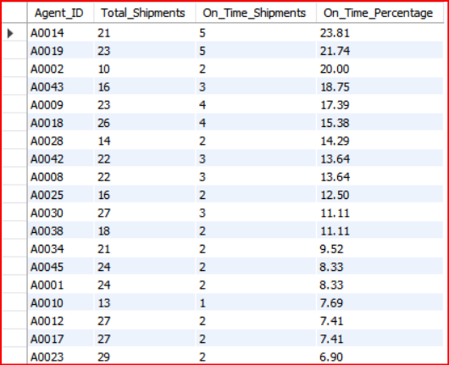
DELIVERY AGENT PERFORMANCE
AGENTS WHOSE ON-TIME % IS BELOW 85%.
WITH agent_performance AS ( SELECT s.Route_ID, s.Agent_ID, COUNT(*) AS Total_Shipments, SUM(CASE WHEN s.Delivery_Status = 'Delivered' AND s.Delay_Hours <= 0 THEN 1 ELSE 0 END) AS OnTime_Shipments, ROUND(SUM(CASE WHEN s.Delivery_Status = 'Delivered' AND s.Delay_Hours <= 0 THEN 1 ELSE 0 END)/ COUNT(*) * 100, 2) AS OnTime_Percentage
FROM fedex_shipments s
GROUP BY s.Route_ID, s.Agent_ID)
SELECT Route_ID,Agent_ID,Total_Shipments, OnTime_Shipments, OnTime_Percentage,RANK() OVER (PARTITION BY Route_ID
ORDER BY OnTime_Percentage DESC) AS OnTime_Rank
FROM agent_performance
ORDER BY Route_ID, OnTime_Rank;
QUERY
OUTPUT

Slide 19

DELIVERY AGENT PERFORMANCE
TOP 5 VS BOTTOM 5 AGENTS
SELECT 'Top 5 Agents' AS Category,ROUND(AVG(Avg_Rating), 2) AS Avg_Rating,ROUND(AVG(Experience_Years), 2) AS Avg_Experience
FROM ( SELECT Avg_Rating, Experience_Years
FROM fedex_delivery_agents
ORDER BY Avg_Rating DESC
LIMIT 5) AS TopAgents
UNION ALL
-- Bottom 5 Agents
SELECT 'Bottom 5 Agents' AS Category, ROUND(AVG(Avg_Rating), 2) AS Avg_Rating, ROUND(AVG(Experience_Years), 2) AS Avg_Experience
FROM (SELECT Avg_Rating, Experience_Years
FROM fedex_delivery_agents
ORDER BY Avg_Rating ASC
LIMIT 5) AS BottomAgents;
QUERY
OUTPUT

Slide 20
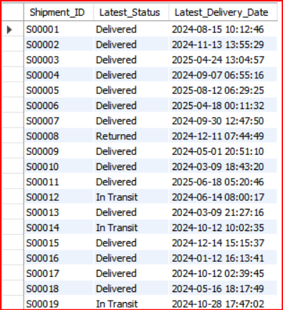
SHIPMENT TRACKING ANALYTICS
THE LATEST STATUS (DELIVERED, IN TRANSIT, OR RETURNED) ALONG WITH THE LATEST DELIVERY_DATE.
SELECT Route_ID, COUNT(*) AS Total_Shipments,
SUM(CASE WHEN Delivery_Status = 'In Transit' THEN 1 ELSE 0 END) AS InTransit_Count,
SUM(CASE WHEN Delivery_Status = 'Returned' THEN 1 ELSE 0 END) AS Returned_Count,
SUM(CASE WHEN Delivery_Status IN ('In Transit', 'Returned') THEN 1 ELSE 0 END) AS Problem_Count
FROM fedex_shipments
GROUP BY Route_ID
HAVING Problem_Count > (Total_Shipments / 2)
ORDER BY Problem_Count DESC;
QUERY
OUTPUT

Slide 21
SHIPMENT TRACKING ANALYTICS
ROUTES WHERE THE MAJORITY OF SHIPMENTS ARE STILL “IN TRANSIT” OR “RETURNED”.
SELECT Route_ID, COUNT(*) AS Total_Shipments,
SUM(CASE WHEN Delivery_Status = 'In Transit' THEN 1 ELSE 0 END) AS InTransit_Count,
SUM(CASE WHEN Delivery_Status = 'Returned' THEN 1 ELSE 0 END) AS Returned_Count,
SUM(CASE WHEN Delivery_Status IN ('In Transit', 'Returned') THEN 1 ELSE 0 END) AS Problem_Count
FROM fedex_shipments
GROUP BY Route_ID
HAVING Problem_Count > (Total_Shipments / 2)
ORDER BY Problem_Count DESC;
QUERY
OUTPUT
THE OUTPUT RETURNS ONLY HEADERS , SO THERE IS

Slide 22
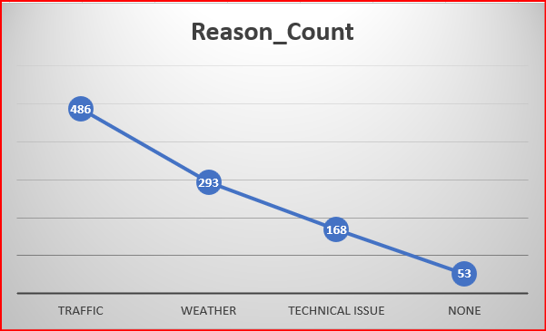
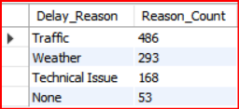
SHIPMENT TRACKING ANALYTICS
THE MOST FREQUENT DELAY REASONS (IF AVAILABLE IN DELAY-RELATED COLUMNS OR FLAGS).
SELECT Delay_Reason,COUNT(*) AS Reason_Count
FROM fedex_shipments
WHERE Delay_Reason IS NOT NULL
AND Delay_Reason <> ''
GROUP BY Delay_Reason
ORDER BY Reason_Count DESC;
QUERY
OUTPUT

Slide 23
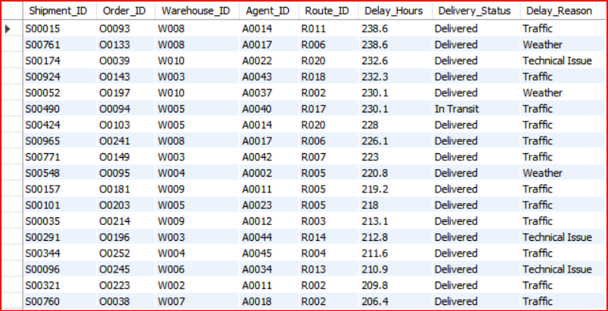
SHIPMENT TRACKING ANALYTICS
ORDERS WITH EXCEPTIONALLY HIGH DELAY (>120 HOURS) TO INVESTIGATE POTENTIAL BOTTLENECKS.
QUERY
SELECT s.Shipment_ID,s.Order_ID,s.Warehouse_ID, s.Agent_ID,s.Route_ID, s.Delay_Hours,s.Delivery_Status,s.Delay_Reason
FROM fedex_shipments s
WHERE s.Delay_Hours > 120
ORDER BY s.Delay_Hours DESC;
OUTPUT

Slide 24
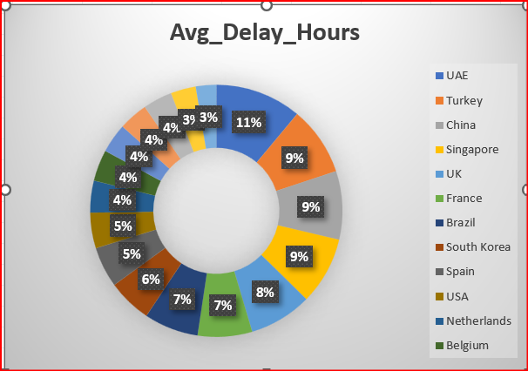
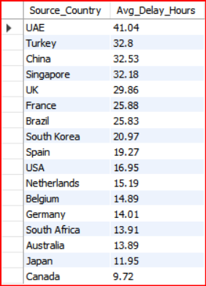
ADVANCED KPI REPORTING
AVERAGE DELIVERY DELAY PER SOURCE_COUNTRY
SELECT r.Source_Country,ROUND(AVG(CASE WHEN s.Delay_Hours IS NULL THEN 0 ELSE s.Delay_Hours END), 2) AS Avg_Delay_Hours
FROM fedex_shipments s
JOIN fedex_routes r
ON s.Route_ID = r.Route_ID
GROUP BY r.Source_Country
ORDER BY Avg_Delay_Hours DESC;
QUERY
OUTPUT

Slide 25

ADVANCED KPI REPORTING
ON-TIME DELIVERY % = (TOTAL ON-TIME DELIVERIES / TOTAL DELIVERIES) * 100.
QUERY
SELECT ROUND(SUM( CASE WHEN s.Delay_Hours <= 0 THEN 1 ELSE 0 END)/ COUNT(*) * 100, 2) AS On_Time_Delivery_Percentage
FROM fedex_shipments s;
OUTPUT

Slide 26
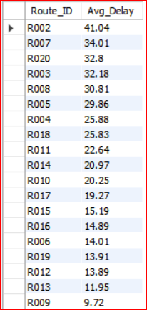
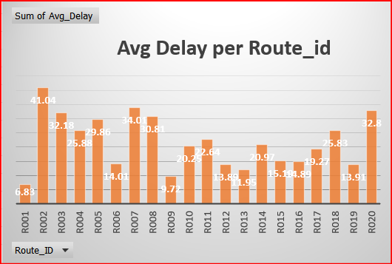
ADVANCED KPI REPORTING
AVERAGE DELAY (IN HOURS) PER ROUTE_ID
QUERY
SELECT Route_ID,ROUND(AVG(CASE WHEN Delay_Hours IS NULL THEN 0 ELSE Delay_Hours END), 2) AS Avg_Delay
FROM fedex_shipments
GROUP BY Route_ID
ORDER BY Avg_Delay DESC;
OUTPUT

Slide 27
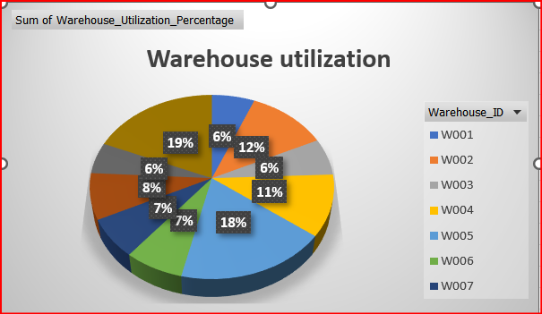
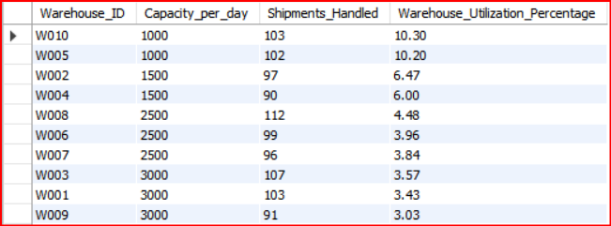
ADVANCED KPI REPORTING
WAREHOUSE UTILIZATION % = (SHIPMENTS_HANDLED / CAPACITY_PER_DAY) * 100.
SELECT w.Warehouse_ID,w.Capacity_per_day, SUM(CASE WHEN s.Shipment_ID IS NOT NULL THEN 1 ELSE 0 END) AS Shipments_Handled,
ROUND(SUM(CASE WHEN s.Shipment_ID IS NOT NULL THEN 1 ELSE 0 END)/ w.Capacity_per_day * 100,2) AS Warehouse_Utilization_Percentage
FROM fedex_warehouses w
LEFT JOIN fedex_shipments s
ON w.Warehouse_ID = s.Warehouse_ID
GROUP BY w.Warehouse_ID, w.Capacity_per_day
ORDER BY Warehouse_Utilization_Percentage DESC;
QUERY
OUTPUT

Slide 28
OVERALL RECOMMENDATION
WAREHOUSE UTILIZATION % = (SHIPMENTS_HANDLED / CAPACITY_PER_DAY) * 100.
FedEx can significantly improve delivery performance by:
  Optimizing underperforming routes (R003, R015, R008) through load balancing & path redesign.
  Strengthening warehouse operations, especially for W004, W003, and W008.
  Training and redistributing workload among low-performing delivery agents.
  Addressing major delay drivers (traffic, weather, technical issues) using predictive analytics.
  Enhancing operational transparency through KPI dashboards and monitoring tools.

Slide 29
THANK YOU

